Slide 1

Optimized Tactical Routing for Unmanned Ground Vehicles
CDT Jacob Hyatt
Advisor: LTC Grymes

Slide 2
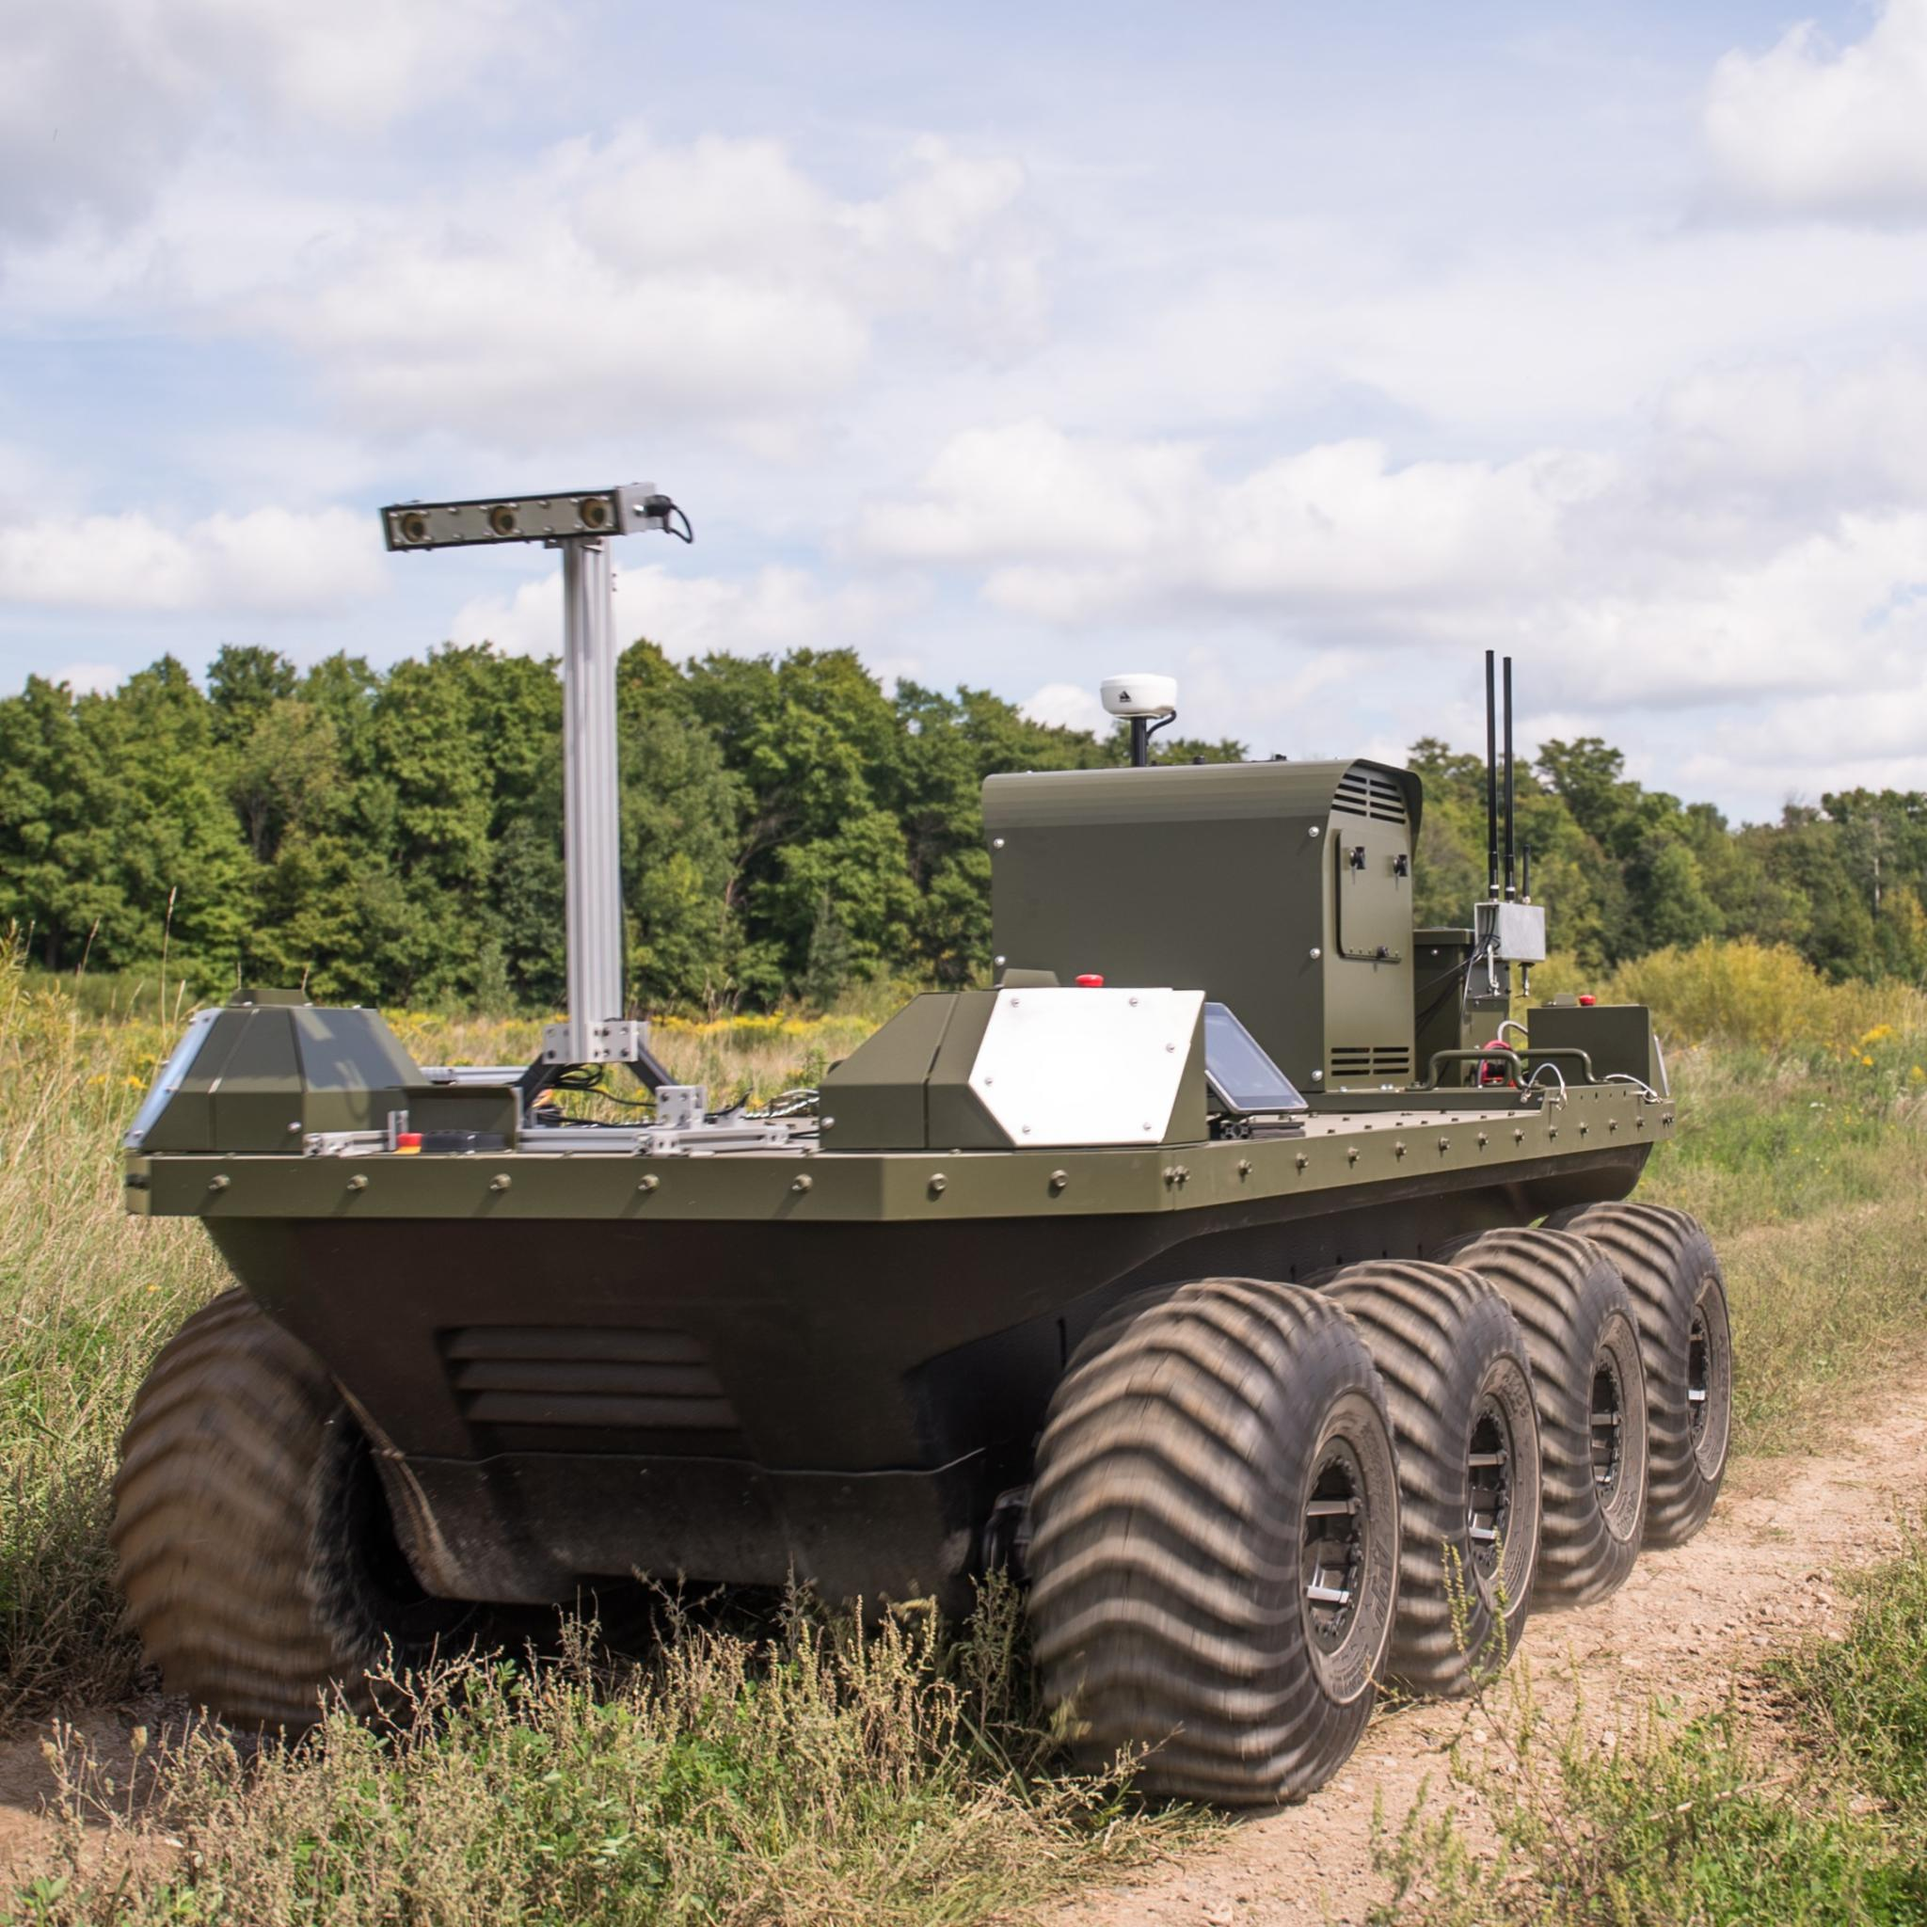
Scope
What is the optimal path for an unmanned ground vehicle in a contested environment?
Notes:
Talk about how this is a platform developed by clearpath robotics called Moose: Give tech specs

Slide 3
Previous Work
4
F
3
Top-Down View
2
S
1
E
E
Walking
Sneaking
Crawling
Probability of Detection
Notes:
Point out the three layers
Moving around an enemy
Probability of detection increases as you move up layers

Slide 4
UGV Adaptations
S
1
2
Top-Down View
E
3
4
F
Charging
Not Charging
Probability of Detection
Notes:
Taking the framework from the last problem to apply it to UGV
UGV have a set battery charge
UGV has a generator that offsets power use, but increase prob of detection due to noise created
UGV can charge using regenerative braking or a generator

Slide 5
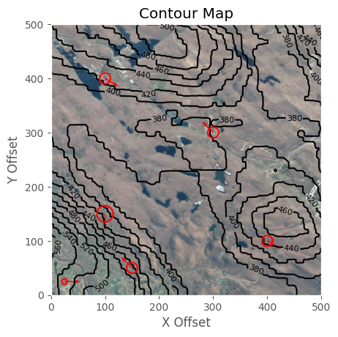
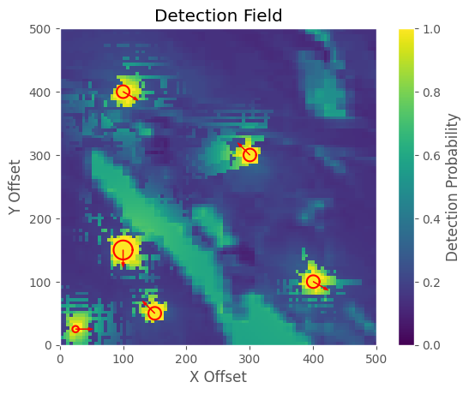
Methodology
Determine edge costs: detection and energy
Solve multi-objective function
Generate multiple paths for leader consideration
Notes:
General Methodology
Multi-objective path function that utilizes detection and energy values
Contour map: introduces the terrain, valley of low vegetation
Detection field: yellow is a higher probability of detection, right on top of enemies means you are detected

Slide 6
Workflow
1
4
2
5
3
6
Retrieve satellite imagery for AO - USGS and ARCGIS
Generate node field over AO at provided step size - Python
Generate detection and energy edge weights - Python
Write these weights and arcs to file - Python
Utilize Gurobi to run multi-objective optimizer – Julia and JuMP
Utilizing path generate statistics and imagery - Python
Notes:
General Methodology
Multi-objective path function that utilizes detection and energy values
Contour map: introduces the terrain, valley of low vegetation
Detection field: yellow is a higher probability of detection, right on top of enemies means you are detected

Slide 7
Objective Function
Minimize the sum of energy expended and the sum of detection probability for each edge along the path*
Energy Expended: calculated through a drive train simulation
Detection Probability: calculated through visual and audio detection functions
*Simulations modeled using JuMP in Julia and Python and Optimized using the Gurobi solver.
Notes:
Point out the two separate equations
Alpha and beta are parameters that can be tuned to change the outcome of the function
Both d_i and E_i have a magnitude between 0 and 1
Minimize the cost function

Slide 8
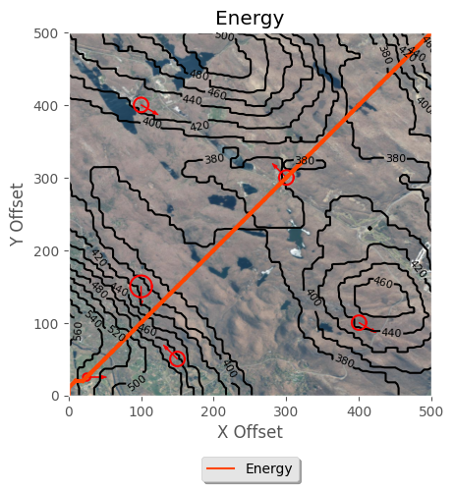
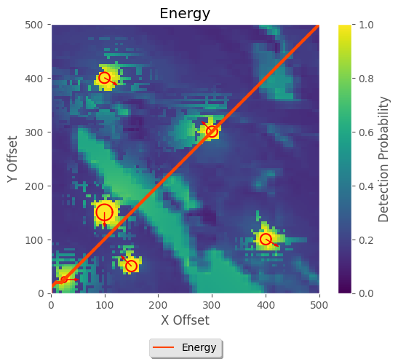
Results
Notes:
Goes straight through enemies
Minimizes the total number of steps taken

Slide 9
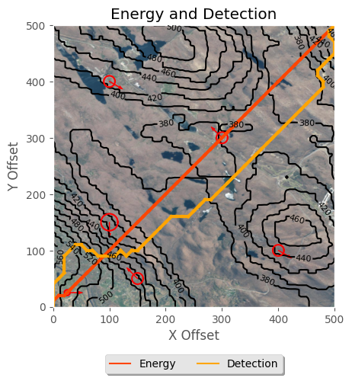
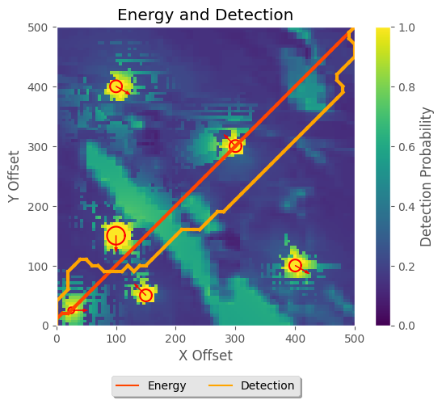
Results
Notes:
Detection moves around enemies

Slide 10
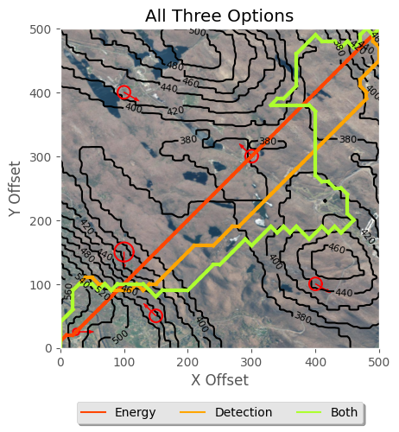
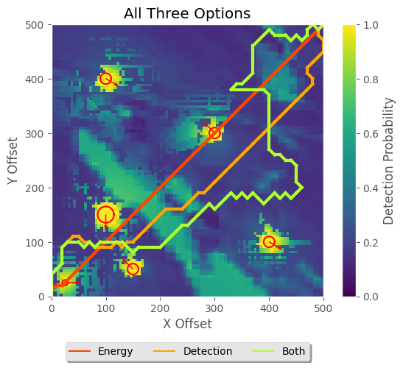
Results
Notes:
Similar to the detection path
Until it diverges
Need to explore why the jagged lines
Hugs the hill to chase changes in elevation

Slide 11
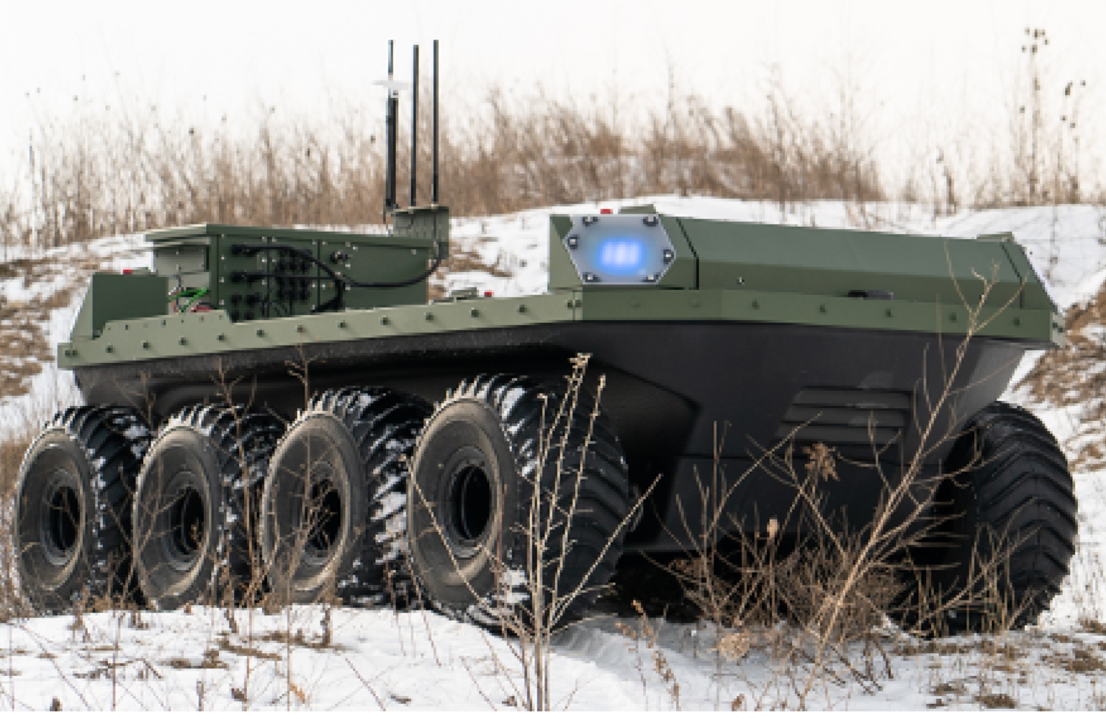
Next Steps
Further Explore Pareto Frontier
Tweak parameter settings
Extend range
Write Paper

Slide 12
RFIs
Are the next steps appropriate?
Add the ability to charge in place?
Journal choice?
Division of labor for the paper?

Slide 13
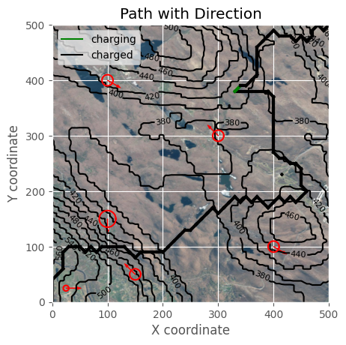
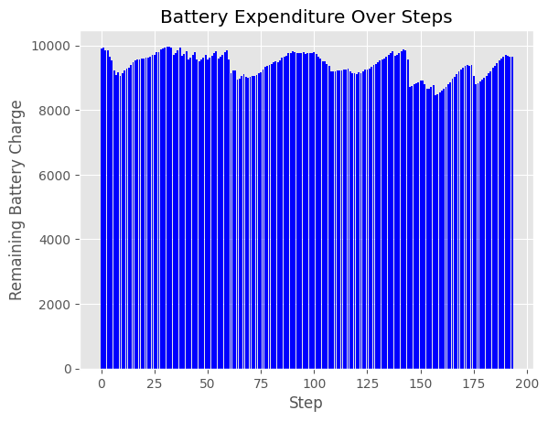
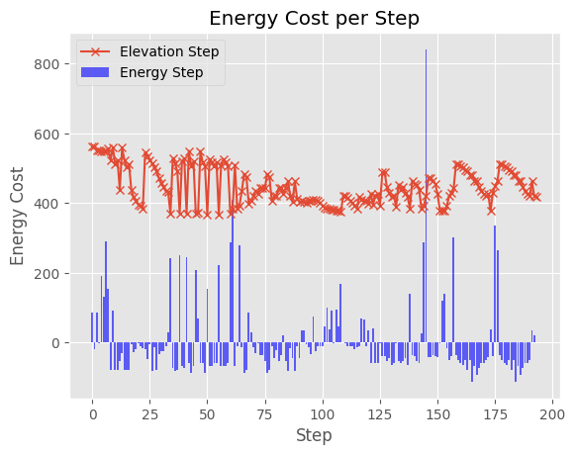
Even Weight

Slide 14
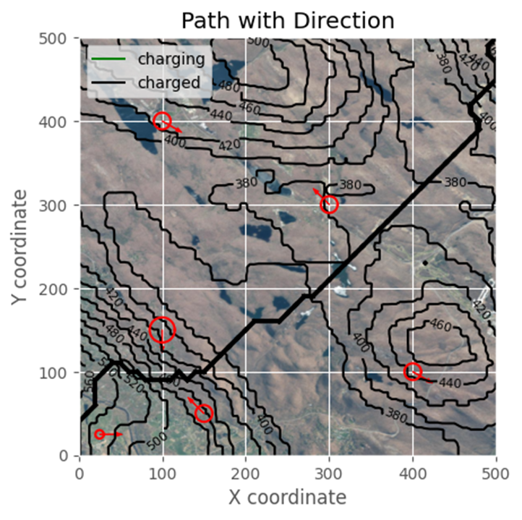
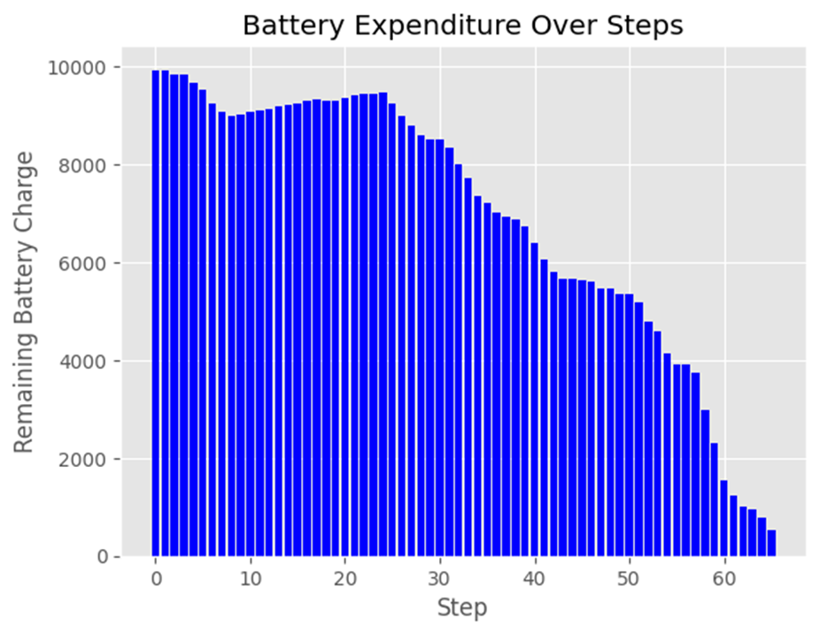
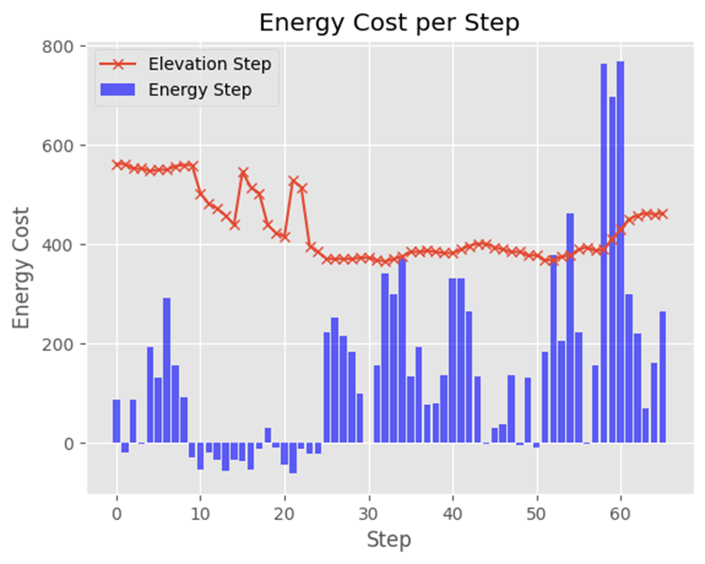
Detection

Slide 15
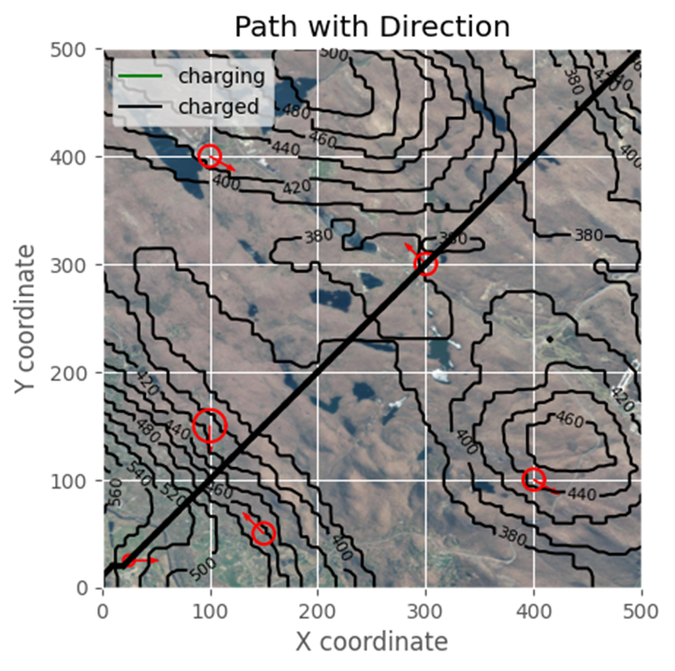
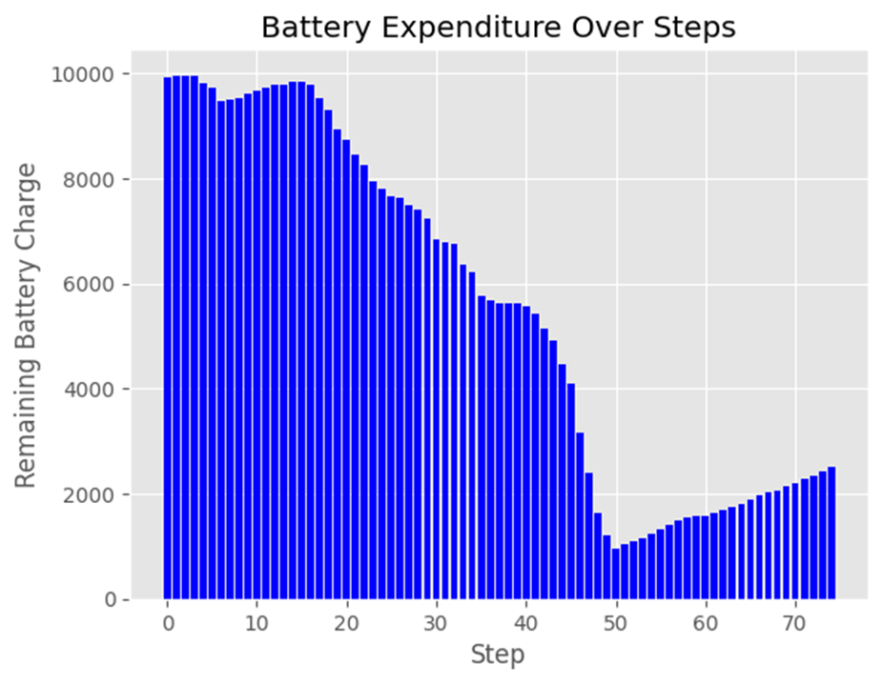
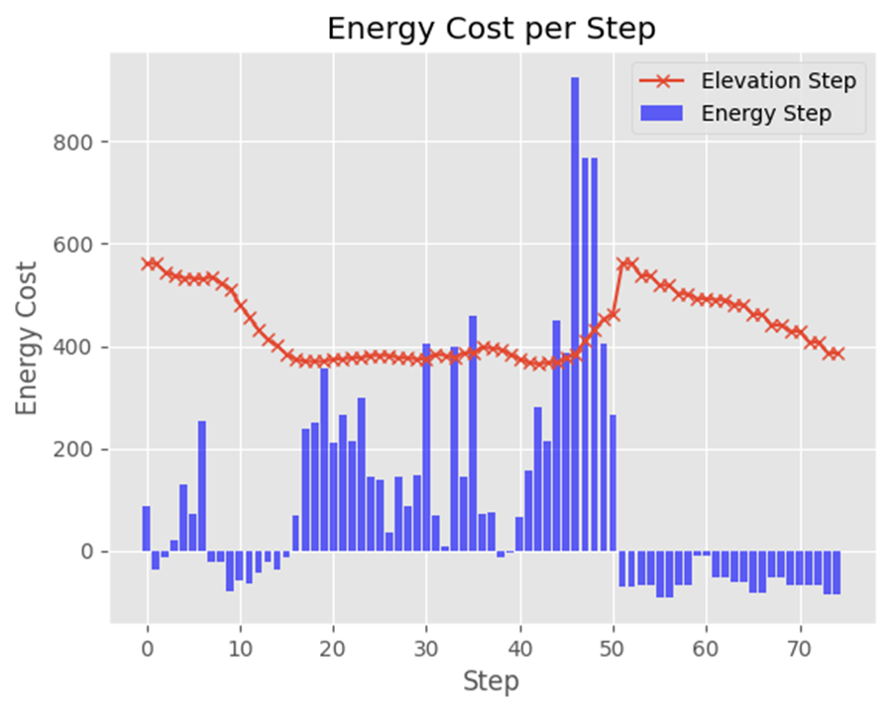
Battery Charge

